Slide 1
Consensus Algorithms

Slide 2
What is Consensus ?
A Procedure to reach common AGREEMENT in a distributed or Decentralized system.
Provides Reliability and Fault tolerance in a distributed or decentralized system
Ensure Correct operations in the presence of faulty individuals
To check Validity of Transactions and Blocks etc.

Slide 3
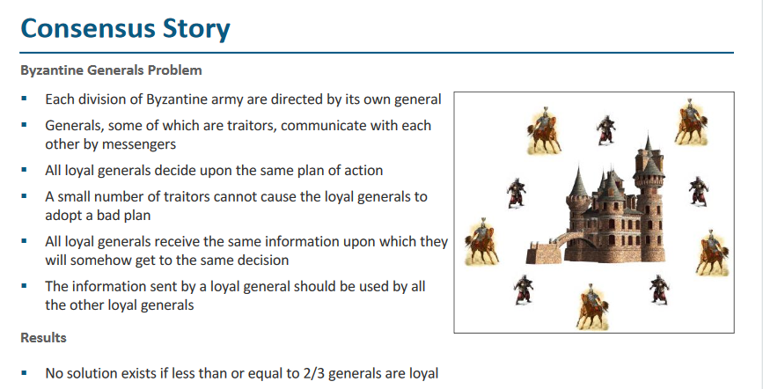

Slide 4
Proof of Work
Find out the nonce which generates the desired hash (certain number of zeros at the prefix (target value))
0000000000000000004a2b84f93a285b7a7………= Difficulty of Mining ->Network
Hn=( H(n-1) || Transactions || Merkle Root || Nonce )

Slide 5
Proof of Stake (PoS)
Miner holding 1% of the Bitcoin can mine 1% of the PoS blocks.
Provides increased protection
Executing an attack is expensive, you need more Bitcoins
Reduced incentive for attack – the attacker needs to own a majority of bitcoins – an attack will have more affect on the attacker

Slide 6
Proof of Burn (PoB)
Miners should show proof that they have burned some coins
Sent them to a verifiably un-spendable address
Expensive just like PoW, but no external resources are used other than the burned coins

Slide 7
PoW vs PoS vs PoB
PoW
PoS
PoB
Do some work to mine a new block
Consumes physical resources, like CPU power and time
Power hungry
Acquire sufficient stake to mine a new block
Consumes no external resource, but participate in transactions
Power efficient
Burn some wealth to mine a new block
Consumes virtual or digital resources, like the coins
Power efficient

Slide 8
Proof of Elapsed Time (PoET)
Proposed by Intel, as a part of Hyperledger Sawtooth – a blockchain platform for building distributed ledger applications
Basic idea:
Each participant in the blockchain network waits a random amount of time
The first participant to finish becomes the leader for the new block

